Slide 1

BASIC COMPUTER ORGANIZATION AND DESIGN

Slide 2
BASIC COMPUTER ORGANIZATION AND DESIGN
• Timing and Control
• Instruction Cycle

Slide 3
TIMING AND CONTROL
Control unit of Basic Computer
Instruction register (IR)
15
14 13 12
11 - 0
Other inputs
3 x 8
decoder
7 6 5 4 3 2 1 0
D
0
Combinational
Control
logic
I
D
Control
signals
7
T
15
T
0
15 14 . . . . 2 1 0
4 x 16
decoder
4-bit
Increment (INR)
sequence
Clear (CLR)
counter
Clock
(SC)

Slide 4
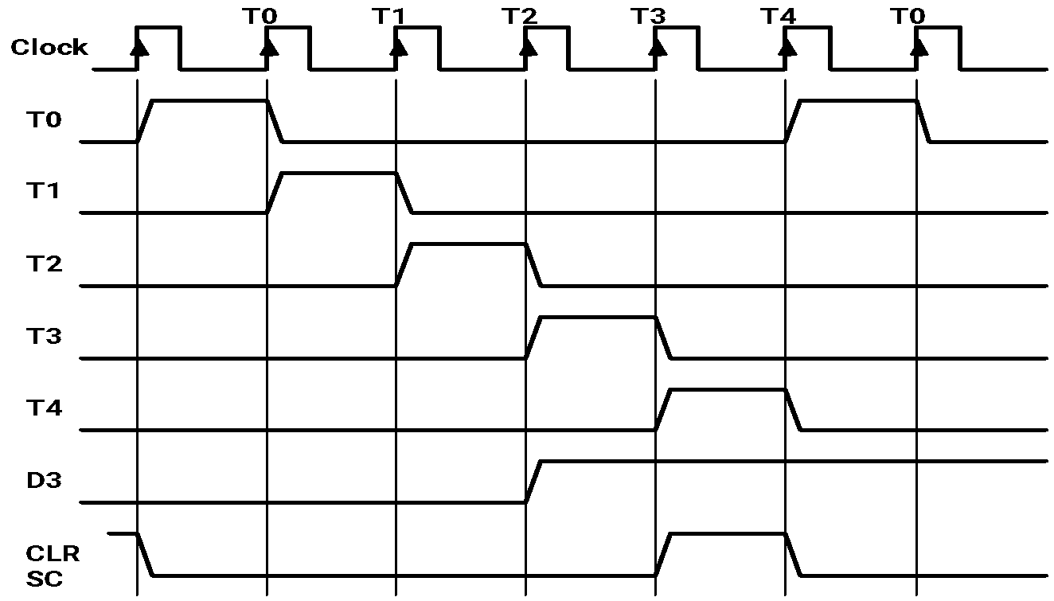
TIMING SIGNALS
- Generated by 4-bit sequence counter and 4×16 decoder
- The SC can be incremented or cleared.
- Example: T₀, T₁, T₂, T₃, T₄, T₀, T₁, . . .
Assume: At time T₄, SC is cleared to 0 if decoder output D3 is active.
D₃T₄: SC ← 0

Slide 5
INSTRUCTION CYCLE
In Basic Computer, a machine instruction is executed in the following cycle:
Fetch an instruction from memory
Decode the instruction and calculate effective address (EA)
Read the EA from memory if the instruction has an indirect address
(Fetch operand)
Execute the instruction
After an instruction is executed, the cycle starts again at step 1, for the next instruction
Note: Every different processor has its own (different) instruction cycle

Slide 6
DETERMINE THE TYPE OF INSTRUCTION
Start
SC ← 0
AR
←
PC
T0
T1
IR
←
M[AR],
PC
←
PC + 1
T2
Decode Opcode in IR(12-14),
AR
←
IR(0-11),
←
I
IR(15)
(Register or I/O) = 1
D7
= 0 (Memory-reference) =>opcode ≠ 111
(I/O) = 1
= 0 (register)
(indirect) = 1
= 0 (direct)
I
I
T3
T3
T3
T3
Execute
Execute
AR
←
M[AR]
Nothing
input-output
register-reference
instruction
instruction
SC
←
0
SC
←
0
Execute
T4
memory-reference
instruction
SC
←
0
D'7IT3: AR ← M[AR]
D'7I'T3: Nothing
D7I'T3: Execute a register-reference instr.
D7IT3: Execute an input-output instr.

Slide 7
REGISTER REFERENCE INSTRUCTIONS
Register Reference Instructions are identified when
- D₇ = 1, I = 0
- Register Ref. Instr. is specified in b₀ ~ b₁₁ of IR
- Execution starts with timing signal T₃
r = D₇ I′T₃ => Register Reference Instruction
B_{i} = IR(i) , i=0,1,2,...,11
r: SC ← 0
CLA rB₁₁: AC ← 0
CLE rB₁₀: E ← 0
CMA rB₉: AC ← AC’
CME rB₈: E ← E’
CIR rB₇: AC ← shr AC, AC(15) ← E, E ← AC(0)
CIL rB₆: AC ← shl AC, AC(0) ← E, E ← AC(15)
INC rB₅: AC ← AC + 1
SPA rB₄: if (AC(15) = 0) then (PC ← PC+1)
SNA rB₃: if (AC(15) = 1) then (PC ← PC+1)
SZA rB₂: if (AC = 0) then (PC ← PC+1)
SZE rB₁: if (E = 0) then (PC ← PC+1)
HLT rB₀: S ← 0 (S is a start-stop flip-flop)

Slide 8
Thanks & Any query ?

